Slide 1
Java I/O System
We have been using variables and arrays for storing data inside the programs.
So Why we need file?

Slide 2
File
File is a collection of related records placed in a particular area on the disk.
Storing and managing data using files is known as file processing, which includes tasks such as Creating files, updating files and manipulating data
A File object is used to obtain or manipulate the information associated with a disk file, such as the permissions, time, date, and directory path, and to navigate subdirectory hierarchies.
Files are a primary source and destination for data within many programs

Slide 3
Writing to a File
To write anything to a file first of all we need a file name we want to use. The file name is a simple string : String fileName = "test.txt";
If you want to write in a file which is located elsewhere you need to define the complete file name and path in your fileName variable:
String fileName = "c:\\filedemo\\test.txt";
To open a file for writing use the FileWriter class and create an instance from it. The file name is passed in the constructor like this:
FileWriter writer = new FileWriter(fileName);
This code opens the file in overwrite mode. If you want to append to the file then :
FileWriter writer = new FileWriter(fileName,true);
Besides this the constructor can throw an IOException so we put all of the code inside a try-catch block.

Slide 4
Ex: Write to File using File Writer
import java.io.*;
String fileName = “c:\\file_test.txt";
try
{
FileWriter writer = new FileWriter(fileName,true);
writer.write("Test text.");
writer.append("Second Text.");
writer.close();
System.out.println("Written to file");
}
catch (IOException e)
{
e.printStackTrace();
}

Slide 5
Ex: Write to File - BufferWriter (more flexibility to handle your IO)
String fileName = "c:\\file_test.txt";
try
{
BufferedWriter writer = new BufferedWriter(new FileWriter(fileName,true));
writer.write("Test text.");
writer.newLine();
writer.write("Line2");
writer.close();
}
catch (IOException e)
{
e.printStackTrace();
}

Slide 6
Ex: Reading from a File
String fileName = "c:\\file_test.txt";
String LS = System.getProperty("line.separator");
StringBuffer fileContent = new StringBuffer();
try
{
FileReader fr = new FileReader(fileName);
BufferedReader reader = new BufferedReader(fr);
String line;
while ((line = reader.readLine()) != null)
{
fileContent.append(line).append(LS);
}
}
catch (IOException e)
{
e.printStackTrace();
}
System.out.println(fileContent.toString());

Slide 7
Some File Methods :
File f = new File(fileName);
System.out.println ("File name: " + f.getName());
System.out.println ("Path:"+ f.getPath ());
System.out.println ("Absolute Path:"+
f.getAbsolutePath ());
System.out.println ("Parent:"+ f.getParent ());
System.out.println ("Exists:"+ f.exists ());
if ( f.exists() ) {
System.out.println ("Is writable: "+ f.canWrite ());
System.out.println ("Is readable: "+ f.canRead ());
System.out.println ("Is executable: "+ f.canExecute ());
System.out.println ("Is directory: "+ f.isDirectory ());
System.out.println ("File size in bytes: "+ f.length ());
}

Slide 8
Directories
A directory is a File that contains a list of other files and directories.
When you create a File object and it is a directory, the isDirectory( ) method will return true. In this case, you can call list( ) on that object to extract the list of other files and directories inside.
It has two forms. The first is shown here:
String[ ] list( )
The list of files is returned in an array of String objects.
The program shown here illustrates how to use list( ) to examine the contents of a directory:

Slide 9
EX:
String dirname = "D:\\javaex";
File f1 = new File(dirname);
if (f1.isDirectory())
{
System.out.println("Directory of " + dirname);
String s[] = f1.list();
for (int i=0; i < s.length; i++)
{
File f = new File(dirname + "/" + s[i]);
if (f.isDirectory()) {
System.out.println(s[i] + " is a directory");
}
else {
System.out.println(s[i] + " is a file");
}
}
}
else {
System.out.println(dirname + " is not a directory");
}

Slide 10
Stream
A Stream represents flow of data from one place to another place.
Input Streams reads or accepts data.
Output Streams sends or writes data.
All streams are represented as classes in java.io package.
The main advantage of using stream concept is to achieve hardware independence. This is because we need not change the stream in our program even though we change the hardware.
Streams are of two types in Java:
Byte Streams
Character or Text Streams

Slide 11
Byte Streams
Handle data in the form of bits and bytes.
Byte streams are used to handle any characters (text), images, audio and video files.
To handle data in the form of 'bytes' the abstract classes: InputStream and OutputStream are used.
The important classes of byte streams are:
FileInputStream/FileOutputStream: They handle data to be read or written to disk files.
FilterInputStream/FilterOutputStream: They read data from one stream and write it to another stream.
ObjectInputStream/ObjectOutputStream: They handle storage of objects and primitive data.

Slide 12
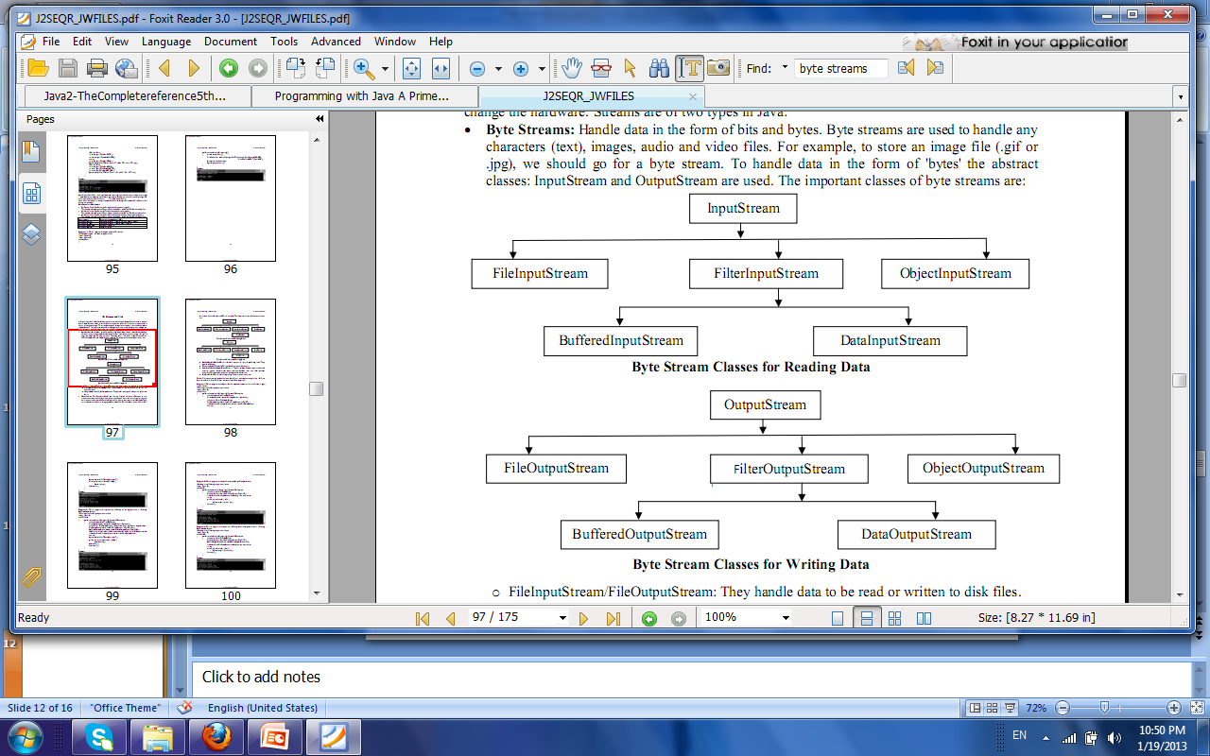

Slide 13
Character or Text Streams
Handle data in the form of characters.
Character or text streams can always store and retrieve data in the form of characters (or text) only.
It means text streams are more suitable for handling text files like the ones we create in Notepad.
They are not suitable to handle the images, audio or video files. To handle data in the form of 'text' the abstract classes: Reader and Writer are used.

Slide 14
The important classes of character streams are:
BufferedReader/BufferedWriter: - Handles characters (text) by buffering them. They provide efficiency.
CharArrayReader/CharArrayWriter: - Handles array of characters.
InputStreamReader/OutputStreamWriter: - They are bridge between byte streams and character streams. Reader reads bytes and then decodes them into 16-bit unicode characters. Writer decodes characters into bytes and then writes.
PrintReader/PrintWriter: - Handle printing of characters on the screen.

Slide 15
